Slide 1
Final Software Project
Travis Henagan
CST499: Capstone for Computer Software Technology
Professor Amr Elchouemi
August 1, 2021

Slide 2
Section 1:
Software Requirements Specification (SRS) Document

Slide 3
The SRS document describes the system that I will be developing in detail. It is used to begin the foundation of an agreement between customers on the functioning of the software.
My SRS document begins with an introduction section which includes, the
Purpose
The purpose of this document is to offer a detailed description of a college registration software system. It will explain the purpose and features of the software, the interfaces of the system, what the software will do
Document conventions
Intended Audience and Reading Suggestions
Product Scope
The university registration system will enable new and existing users the ability to register an account along with profile creation.
References
Any references that were cited throughout the documentation

Slide 4
SRS Documentation continued..
Section 2 consist of the overall description of the product.
Product Perspective
a new registration system in development. It will be structured based on research from previous systems with similar attributes. This system will be user friendly as the target audience may not have used a similar system before. This system will allow new users an experience to gain all the functions of the registration system.
Product functions
New user registration that includes account and profile creation
Each new user should have a unique ID associated with a password. The system will guard against two users using the same ID for registration
Profiles must include some key information about the applicant including name, phone, email, and any other information you may see necessary.
Post registration, users can login to the system at any time using the ID and the password
created during the registration process.

Slide 5
Section 2:
UML design models

Slide 6
UML Design Models
I created multiple UML document, which would be used to put together and have a visual of the system. The three types of UML documents that I created were:
Class The class diagrams show the structure of a system, showing the system's classes, their attributes, and the relationships between objects.
Sequence - shows the objects involved in the scenario and the sequence of messages substituted between the objects needed to carry how the scenario functions.
Use-Case - shows several use cases and diverse types of users the system has.

Slide 7
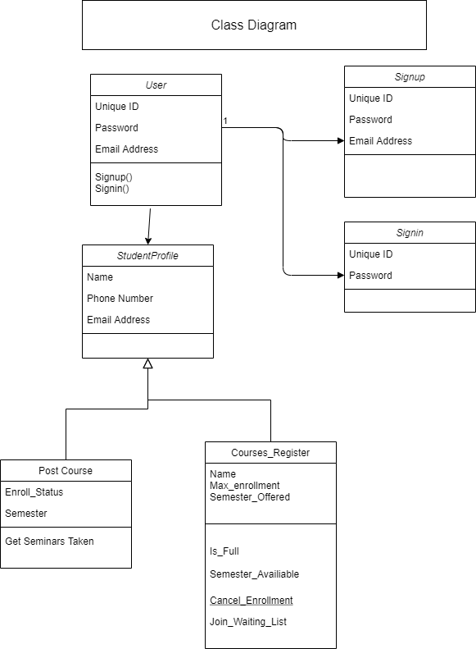
Class Diagram
The class diagram shows how the classes will connect together
The User class will be connected and interact with the Student Profile class.
The Student Profile class will call be connected with the past course class and Courses that are registered.

Slide 8
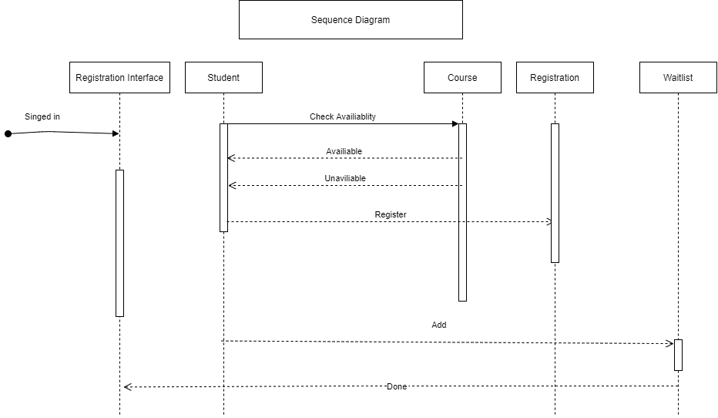
Sequence Diagram
The sequence diagram begins with the signin of the student.
The sign-in page will then send message to the registration interface.
The student will interact with the course page which it will be able to register for classes, adding available classes, dropping classes or sending their name to the waitlist of full classes.
When a student chooses a course that is available, they will be able to register for it.

Slide 9
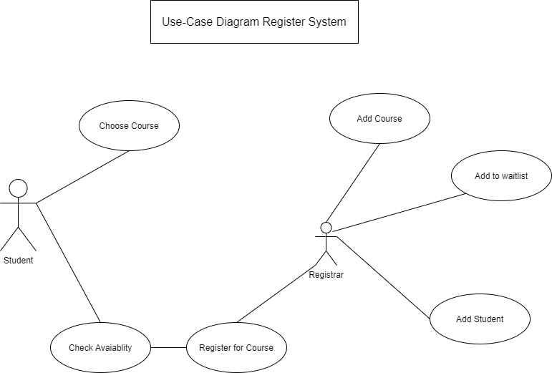
Use-Case
The use-case diagram shows the actor (student) and how the student can choose to interact with the system.
The student has a choice of courses to choose from.
The student can view available courses.
The student can register for courses after viewing them.
The second actor is the systems registrar, which will add the courses that the student chooses, or add the student to the waitlist of the course.

Slide 10
Section 3:
Design of landing, login pages

Slide 11
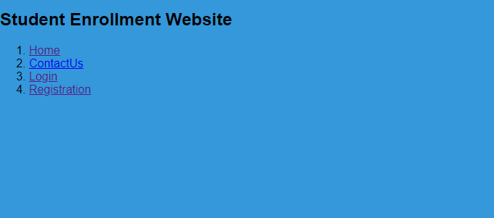
Landing page
The landing page will allow the user to choose what they would like to do.
The user can Register as a new user.
The User can login as an existing user.
The User may also go to the contact us page which will allow them to learn about the website.

Slide 12
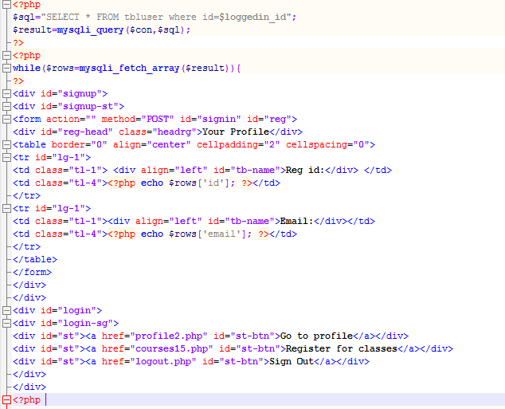
Landing Page PHP code
The landing page PHP code uses HTML code to assist in placing links to the page.
href – is used to post a link along with the connected PHP file. This will redirect the User when the link is selected.

Slide 13
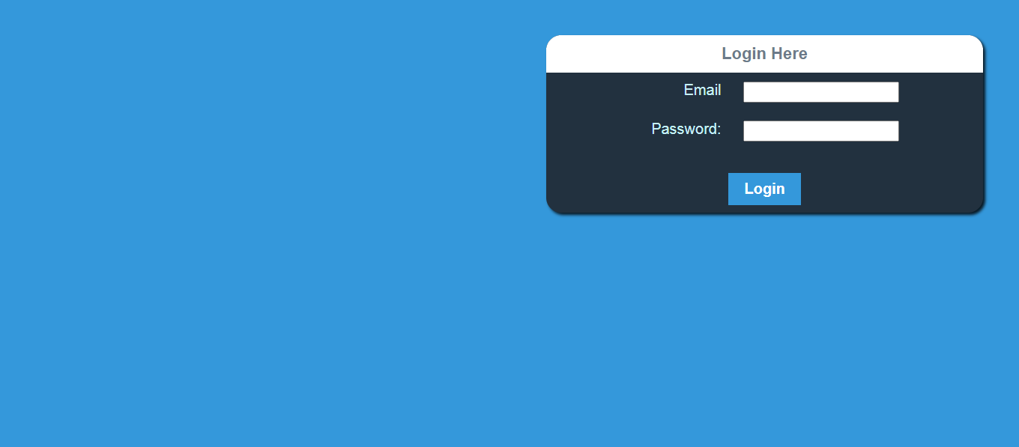
Login Page
Login page allows the User to login with their email and password
This page is connected to the MySQL database that will contain the information that was presented during registration of their email and password

Slide 14
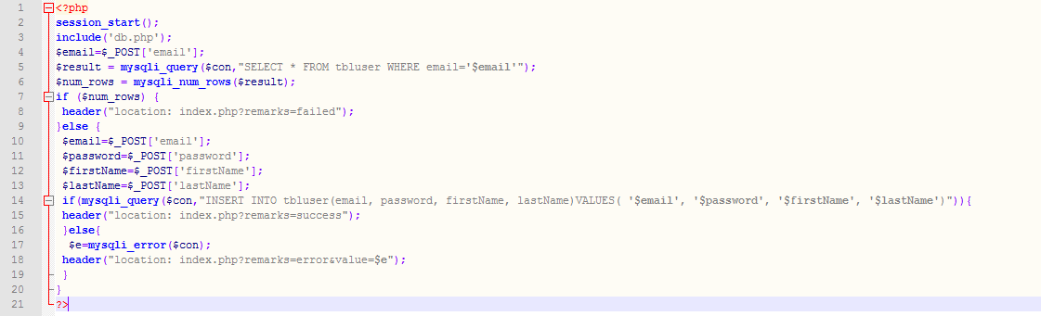
Login Page PHP Code
The PHP code uses the POST statement which will post the information that is entered.
The code makes use of a SQL statement inside an if statement to sent and receive information from the datbase

Slide 15
Section 3:
MySQL Database

Slide 16
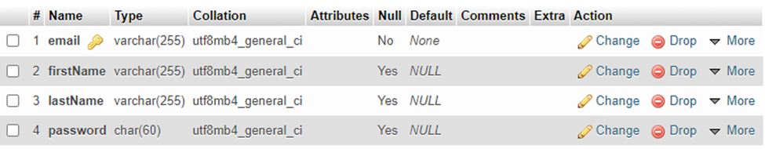
MySQL databases of User Information
The MySQL will display tables of the Users information. First name, Last name, email and password
This will allow information to be given and received from the database as it is added.

Slide 17
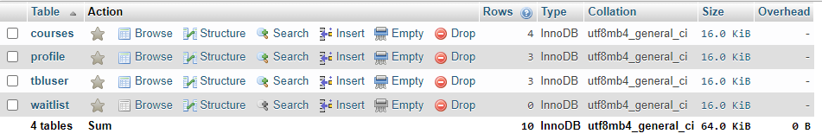
MySQL database tables for course registration
The picture below shows the tables that I developed for the database.
The database would be searched during the interaction that the User has with the website
When courses are added, deleted, or a student adds themselves to the waitlist for courses.

Slide 18
Section 4:
References

Slide 19
Chikh, A., & Alajmi, H. (2014, January 17–19). Towards a dynamic software requirements specification [Paper presentation]. 2014 World Congress on Computer Applications and Information Systems (WCCAIS), Hammamet, Tunisia. https://doi.org/10.1109/WCCAIS.2014.6916656
Dvorski, D. D. (2007). Installing, configuring, and developing with Xampp. Skills Canada.
SQL CREATE TABLE Statement. W3schools.com. Retrieved from https://www.w3schools.com/sql/sql_create_table.asp.
Homès, B. (2012). Fundamentals of software testing. Wiley.
Kawane, N. (2003, November). Fault detection effectiveness of UML design model test adequacy criteria. In Supplementary Proceedings of the International Symposium on Software Reliability Engineering (pp. 327-328).
Spillner, A., Linz, T., & Schaefer, H. (2014). Software testing foundations: A study guide for the certified tester exam (4th ed.). Rocky Nook.
Steps in Top Down Integration Testing - GeeksforGeeks. GeeksforGeeks. (2020). Retrieved from https://www.geeksforgeeks.org/steps-in-top-down-integration-testing/.
Wiegers, K. E. (1999). Software requirement specifications for <project> (Links to an external site.) [Template]. https://web.cs.dal.ca/~hawkey/3130/srs_template-ieee.doc

